Slide 1
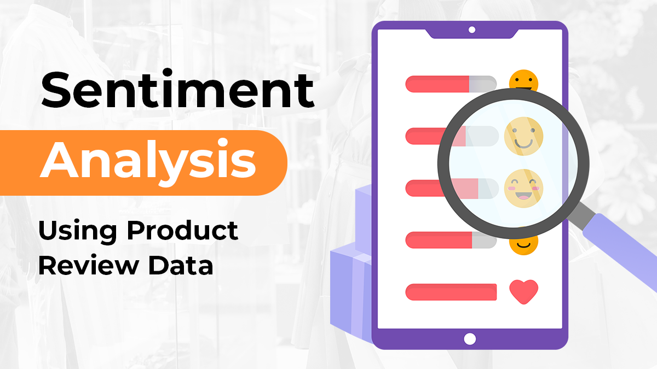
SENTIMENT ANALYSIS
MINOR PROJECT REPORT

Slide 2
TEAM STRUCTURE:
REQUIREMEMT GATHERING TEAM: Jagrati Yadav and Aanya Singhai
DESIGN TEAM : Aditi Tiwari , Aanya Singhai
CODING TEAM : Aditi Tiwari ,Anshika Gupta
TESTING TEAM : Aditi Tiwari, Anshika Gupta

Slide 3

BACHELOR OF TECHNOLOGY in COMPUTER SCIENCE AND ENGINEERING DEPARTMENT OF COMPUTER SCIENCE AND ENGINEERING GYAN GANGA INSTITUTE OF TECHNOLOGY & SCIENCES JABALPUR (M.P.) RAJIV GANDHI PRODYOGIKI VISHWAVIDYALAYA, BHOPAL (M.P.) september - 2023

Slide 4
1.INTRODUCTION ::
Sentiment is an attitude, thought, or judgement prompted by feeling. Sentiment analysis, which is also known as opinion mining, studies people’s sentiments towards certain entities. Sentiment analysis and classification is a computational study which attempts to address this problem by extracting subjective information from the given texts in natural language, such as opinions and sentiments.
As online marketplaces have been popular during the past decades, the online sellers and merchants ask their purchasers to share their opinions about the products they have bought. Everyday millions of reviews are generated all over the Internet about different products, services and places. This has made the Internet the most important source of getting ideas and opinions about a product or a service. However, as the number of reviews available for a product grows, it is becoming more difficult for a potential consumer to make a good decision on whether to buy the product. Different opinions about the same product on one hand and ambiguous reviews on the other hand makes customers more confused to get the right decision. Here the need for analysing this content seems crucial for all e-commerce businesses.

Slide 5
1.1.Purpose :
Amazon is one of the e-commerce giants that people are using every day for online purchases where they can read thousands of reviews dropped by other customers about their desired products. These reviews provide valuable opinions about a product such as its property, quality and recommendations which helps the purchasers to understand almost every detail of a product. This is not only beneficial for consumers but also helps sellers who are manufacturing their own products to understand the consumers and their needs better.
This project is considering the sentiment classification problem for online reviews using supervised approaches to determine the overall semantic of customer reviews by classifying them into positive, negative and neutral sentiment.

Slide 6
1.2.Scope :
Firstly, evaluative terms expressing opinions must be extracted from the review. Secondly, the SO, or the polarity, of the opinions must be determined. Thirdly, the opinion strength, or the intensity, of an opinion should also be determined. Finally, the review is classified with respect to sentiment classes, such as Positive, Negative and neutral based on the SO of the opinions it contains.

Slide 7
2.THE OVERALL DESCRIPTION:
2.1.Product Perspective:
The perspective of Sentiment Analysis is that this product will help businesses by providing insights into customer opinions on Amazon, which will allow them to make informed decisions,
improve products,
respond to issues,
enhance marketing efforts,
ultimately drive growth and
customer satisfaction.

Slide 8
2.2.System Interfaces:
2.2.1.Hardware :
Processor | Intel Core i5
RAM | At Least 8 GB
Hard Drive | 256 GB SSD

Slide 9
2.2.2.Software:
DATABASE | MS WORD
API | DJango
Tools & Tech | Pytest ,JUPYTER NOTEBOOK, GOOGLE COLAB
Language | PYTHON

Slide 10
3. SPECIFIC REQUIREMENTS:
3.1. Functions:
1.Where pertinent , convenient , error messages are sent.
2.Monitor addition, deletion, and alteration as necessary.
3.Reliable user interface with extremely practical features.

Slide 11
3.2.1.Non-Functional Requirements:
⦁One element of the software requirements specification document is non-functional requirements (SRS document). This paper focuses on the functions and performance expectations for the software. It also discusses what is necessary in terms of functionality from the viewpoint of the user.
⦁The SRS documents include a few sections, such as a description of the system. High- level information regarding the system is provided in the overview. Any relevant concepts are described in a glossary-like format up front. A broad description. Any presumptions made regarding the project and the overall goal or theme are described in this section specific conditions. The functional and non-functional needs are included in this section.
⦁A software system's quality characteristic is defined by a non-functional requirement. They stand for a set of criteria used to assess particular performance of a system. For instance, how quickly does the website load and responses.
⦁To guarantee the overall software system's usability and efficacy, a non-functional requirement is necessary. Systems that don't meet non-functional requirements may not be able to meet user’s needs.
You can impose constraints or limitations on the system architecture across different agile backlogs using non-functional requirements. When there are many users working online at once, the website should load fast as if in a few seconds, for instance. It is as important as a functional requirement.

Slide 12
3.2.2. Functional Requirements:
Positive
Negative or
The user must get information about the sentiment of the reviews whether they are-
Neutral

Slide 13
SOFTWARE SYSTEM ATTRIBUTES:
Accuracy : The system should accurately classify sentiments in Amazon product reviews, minimizing false positives and negatives.
Performance: The sentiment analysis process should be efficient, providing timely results even for a large volume of reviews.
Scalability: The system should scale to handle a diverse range of product categories and adapt to varying review volumes without significant degradation in performance.
Adaptability: The ability to adapt to changes in language trends, new products, and evolving sentiments over time.
Multilingual Support: If applicable, the system should support sentiment analysis for reviews in multiple languages commonly found on the Amazon platform.
Context Awareness: Understanding and accounting for the context in which sentiments are expressed, as reviews can be nuanced and context-dependent.
Domain Specificity: The sentiment analysis model should be trained and fine-tuned on a dataset that accurately represents the diversity of products available on Amazon.
Real-time Processing: Providing sentiment analysis results in real-time or near-real-time to support quick decision-making for users.
Explainability: The system should provide insights into why a particular sentiment classification was made, enhancing transparency and trust in the results.
Security : Ensuring the security and privacy of the review data, especially if the sentiment analysis system is handling sensitive information.
User Interface Integration : Integrating seamlessly into user interfaces to allow users, such as potential buyers or sellers, to easily interpret sentiment analysis results.
Feedback Mechanism : Incorporating a feedback mechanism to continuously improve the sentiment analysis model based on user corrections or updates to sentiment classifications.

Slide 14
3.3.Features:
As the number of reviews available for a product grows, it is becoming more difficult for a potential consumer to make a good decision on whether to buy the product. Different opinions about the same product on one hand and ambiguous reviews on the other hand makes customers more confused to get the right decision. Here the need for analysing this content seems crucial for all Amazon businesses.

Slide 15
4.0. design Features [ diagrams ]:
The following features make Concept Draw DIAGRAM the best Data Flow Diagram software:
You may quickly create diagrams with a professional appearance without being an artist.
The abundance of premade vector components makes it simple and rapid to construct diagrams.
A large selection of pre-made templates and examples provide you a solid place to start when creating your own diagrams.
You have the option to use the grid, rules, and guides in Concept Draw DIAGRAM. To make your diagram seem remarkable, you may effortlessly rotate, organise, align, arrange the components, and use various fonts and colours.
All ConceptDraw DIAGRAM documents are vector graphic files that may be edited, reviewed, and converted to a number of different file types, including images, HTML, PDF files, Microsoft PowerPoint presentations, Adobe Flash.

Slide 16
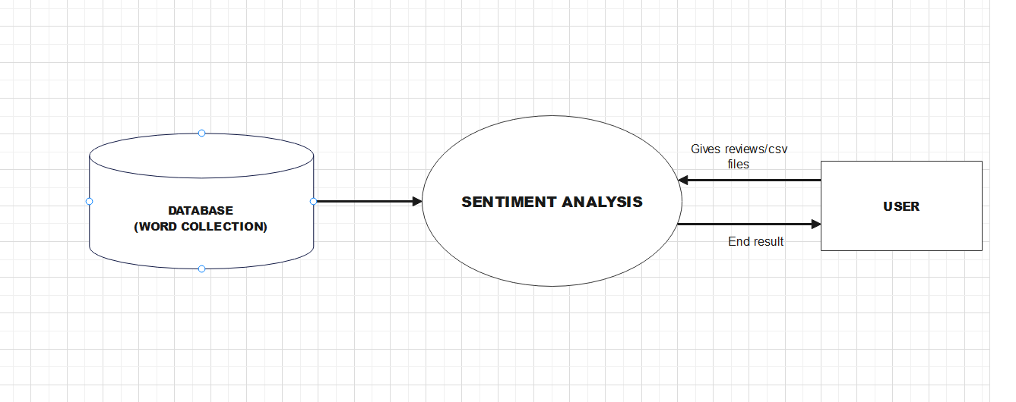
0- Level Description:

Slide 17
BASIC DESCRIPTION OF 0-LEVEL DFD:
A zero level DFD or context diagram is a data flow diagram that shows the entire system as a single process with its relationship to external entities. As we know, a 0-level DFD is called a content diagram. It's a basic overview of the whole system or process being analysed or modelled.
Here for our project "Sentiment Analysis' ' the following is the 0- level diagram that shows the basic structure of the system or model.
Here we have a database (to fetch for the positive, negative and neutral words), a model /system/ software, and user.
Here the user gives the reviews of Amazon to the software and with the help of the database, software returns the final or the end result of the process.

Slide 18
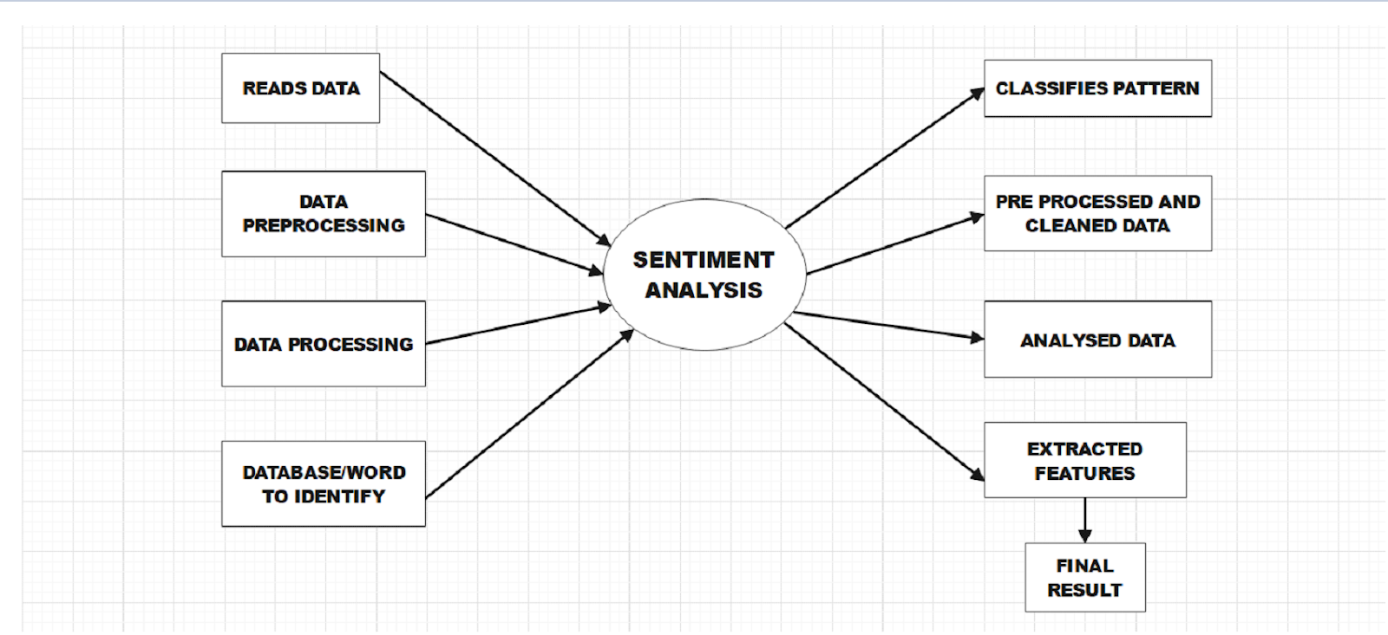
1-Level Description:

Slide 19
BASIC DESCRIPTION OF 1-LEVEL DFD:
A 1 level DFD breaks down the main process into subprocesses that can then be seen on a deeper level. Also, level 1 DFD contains data stores that are used by the main process.
As we know that 1- level DFD provides a more detailed view of the system by breaking down the major process identified in O level into subproblems.We have inputs and outputs of the process. Here the “SENTIMENT ANALYSIS”, has several inputs like:
Read data
Data Preprocessing
Data Processing
Database/ words to identify
Outputs or subprocesses like classified to final results

Slide 20
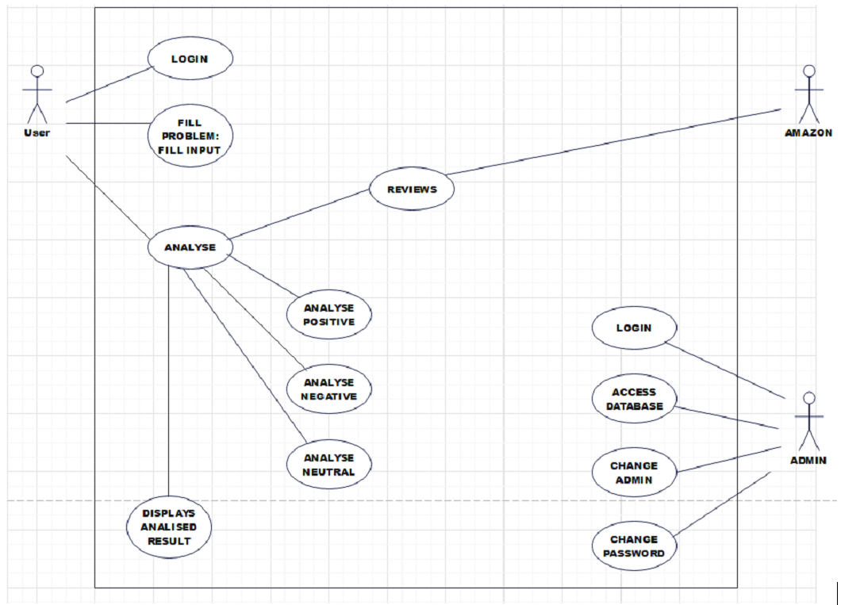
Use Case Diagram:

Slide 21
BASIC DESCRIPTION OF USE CASE:
In the Unified Modelling Language (UML), a use case diagram can summarize the details of your system's users (also known as actors) and their interactions with the system. To build one, you'll use a set of specialized symbols and connectors. An effective use case diagram can help your team discuss and represent:
Scenarios in which your system or application interacts with people, organizations, or external systems.
Goals that your system or application helps those entities (known as actors) achieve.
The scope of your system.

Slide 22
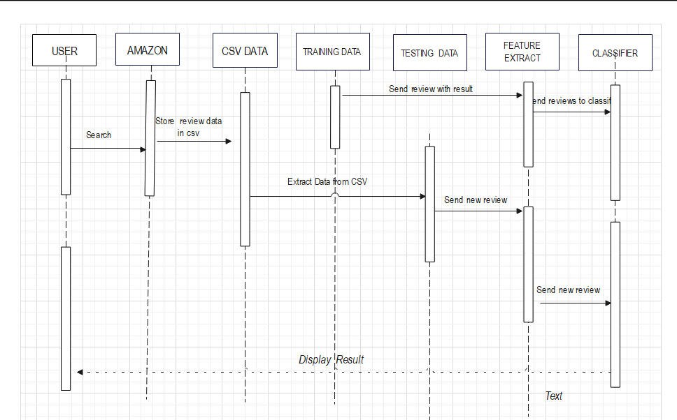
Sequence diagram:

Slide 23
BASIC DESCRIPTION OF sequence diagram :
A sequence diagram is a Unified Modeling Language (UML) diagram that illustrates the sequence of messages between objects in an interaction. A sequence diagram consists of a group of objects that are represented by lifelines, and the messages that they exchange over time during the interaction.

Slide 24
5.0 The problem statement:
Create a system for sentiment analysis to analyse and categorise the opinions stated in Amazon product reviews. The objective is to automatically determine, from the ideas and feelings expressed in the text, whether a particular review is positive, negative, or neutral. The system should be able to handle a large volume of diverse product reviews, considering variations in language, context, and sentiment intensity. To ensure the model's usefulness across several product categories, it should also be trained and validated on a dataset that appropriately depicts the variety of items accessible on Amazon. The ultimate goal is to offer insightful information on customer attitudes so that prospective customers can make well-informed judgements and merchants may better grasp the advantages and disadvantages of their offerings.

Slide 25
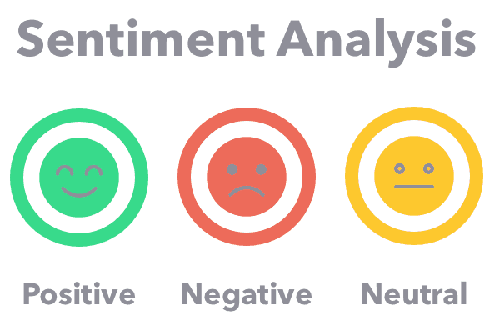


Slide 26
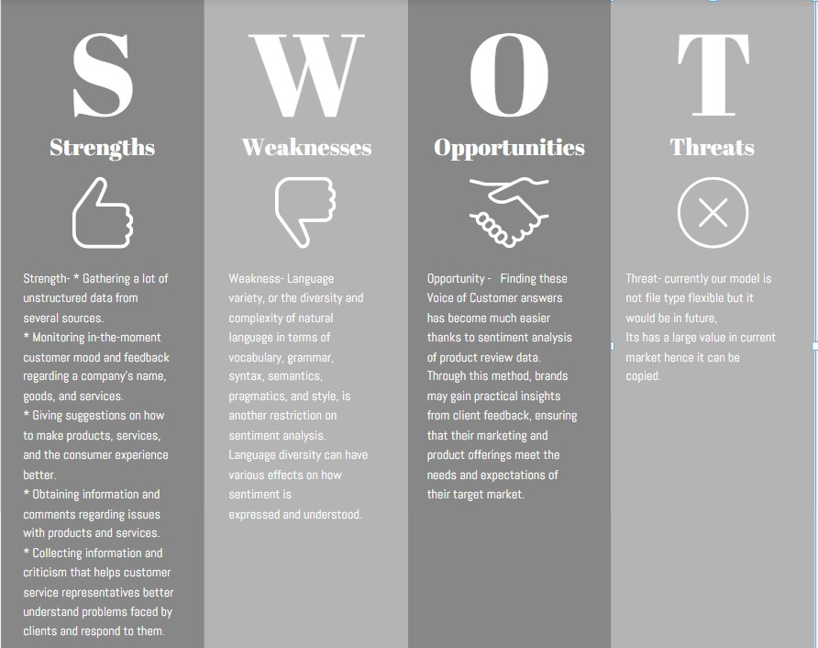
SWOT ANALYSIS:

Slide 27

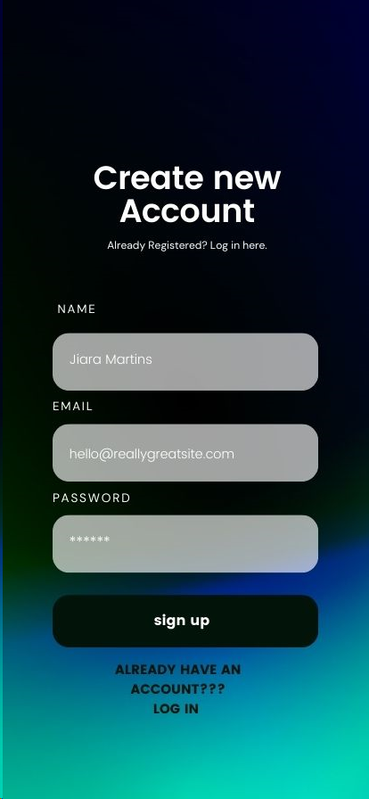
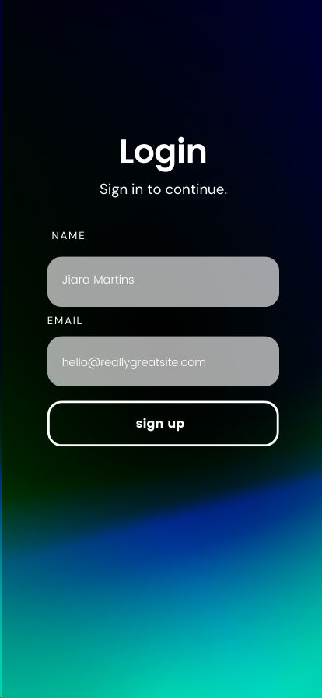
RESULT :

Slide 28
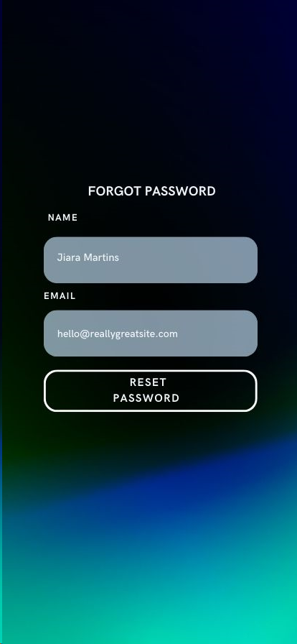
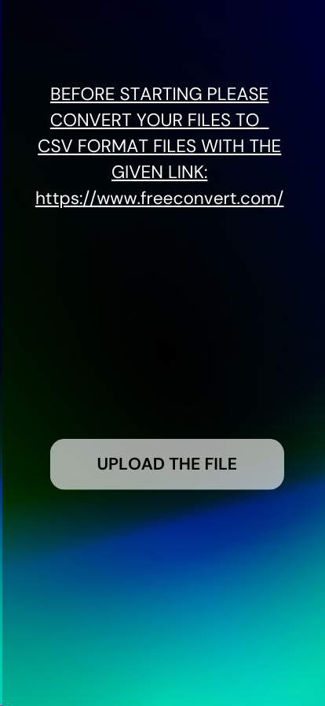


Slide 29
SUBMITTED BY: NAMES: ADITI TIWARI AANYA SINGHAI ANSHIKA GUPTA JAGRATI YADAV

